Slide 1
Taking the Fear out of Tabular Editor
Notes:
Who – where from?
Have you used Tabular Editor?

Slide 2

Sue Bayes https://www.linkedin.com/in/suebayes/
Independent Power BI developer
Own business
Time is important
Not employed by Tabular Editor
www.databayes.co.uk
https://www.meetup.com/devon-and-cornwall-power-bi-meetup-group/
Notes:
Who – where from?
Have you used Tabular Editor?

Slide 3






Sponsors – Thank you
We couldn’t do it without you.

Slide 4
Tabular Editor
What is it?
How much will it cost me?
Who uses it?
Why?
How do I start?

Slide 5

Tabular Editor: In a Nutshell
Windows Desktop Application: Tabular Editor 2 & Tabular Editor 3 (TE3)
View & Edit Data Models
Microsoft Fabric
Power Bl Premium
Power Bl Desktop
Azure Analysis Services
SQL Server 2016+ Analysis Services
Save time & make better data models
Notes:
Tabular Editor is a Windows application for managing tabular models
You use Tabular Editor to manage metadata in remote or local models deployed to Analysis Services.
You both read and write to the model, using features that help you make better data models, faster.
https://docs.tabulareditor.com/te3/getting-started.html

Slide 6
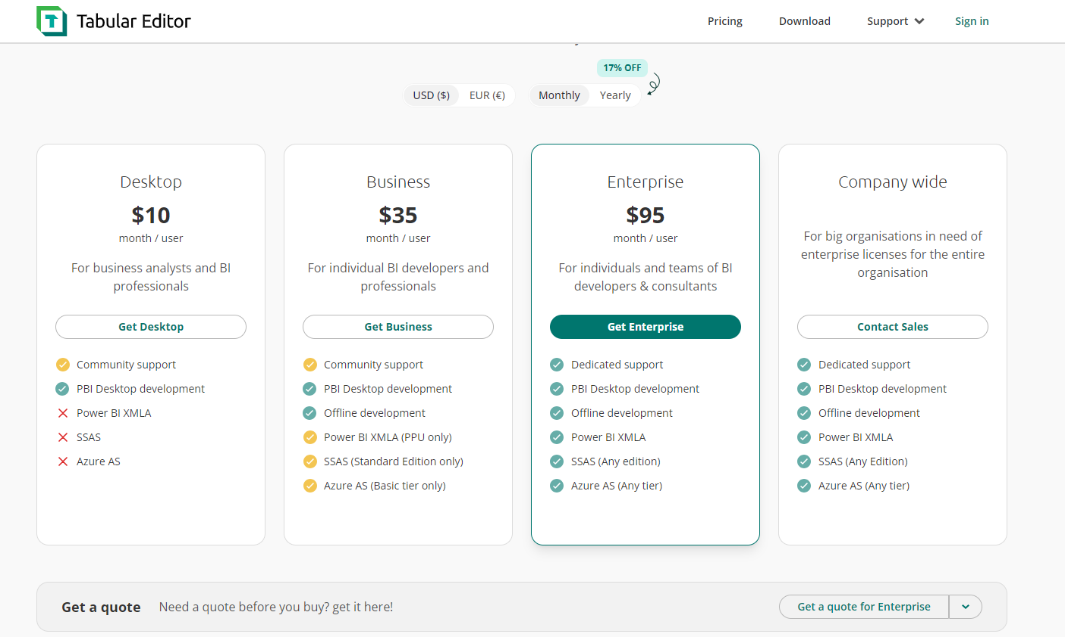
Licenses

Slide 7
Use Cases
Desktop Analyst – external tool
Support Engineer - many models remotely, read/refresh
Team or Enterprise data Model Developer – create and manage
Solution Architect – source control and CI/CD
(continuous integration and continuous deployment )
Notes:
- using Tabular Editor as a Power Bl Desktop external tool.
- manage model metadata in .bim or database.json files.
- These files are eventually deployed to Analysis Services or the Power Bl service.
Connect to a remote model in SSAS/AAS or Power Bl if you are a DB administrator – PPU or Premium
Connect with Workspace Mode
Connect to a local model metadata and a remote database at the same time
Benefit from connected features while also saving changes to source control
Recommended for Development, and not Test or Production environments
Use separate Workspace Databases for separate developers when working on the same model
Workspace Mode can overwrite other changes made outside the model file. i.e. in other tools.
13 The Workspace Mode connection is located in the .tmuo file, created in the same directory as
the model metadata file.
A continuous integration and continuous deployment (CI/CD) pipeline is a series of steps that must be performed in order to deliver a new version of software. CI/CD pipelines are a practice focused on improving software delivery throughout the software development life cycle via automation

Slide 8
Making better data models, faster
Automate tasks & enhancing productivity
Help optimize data models
Write better DAX in less time
Unlock advanced modelling features
https://docs.tabulareditor.com/?tabs=TE3
Notes:
Automate – Batch Tasking, Automate control and model validation, Automate tasks and script development
Organise and Optimise – Organise – display folders, group, hidden and private
Validate and explore data with query features – preview, pivot, dax
Analyse models with Vertipaq
DAX – DAX code assistant, syntax, dax debugger
Advanced Modelling – Calc Groups, Perspectives, OLS, Translations

Slide 9
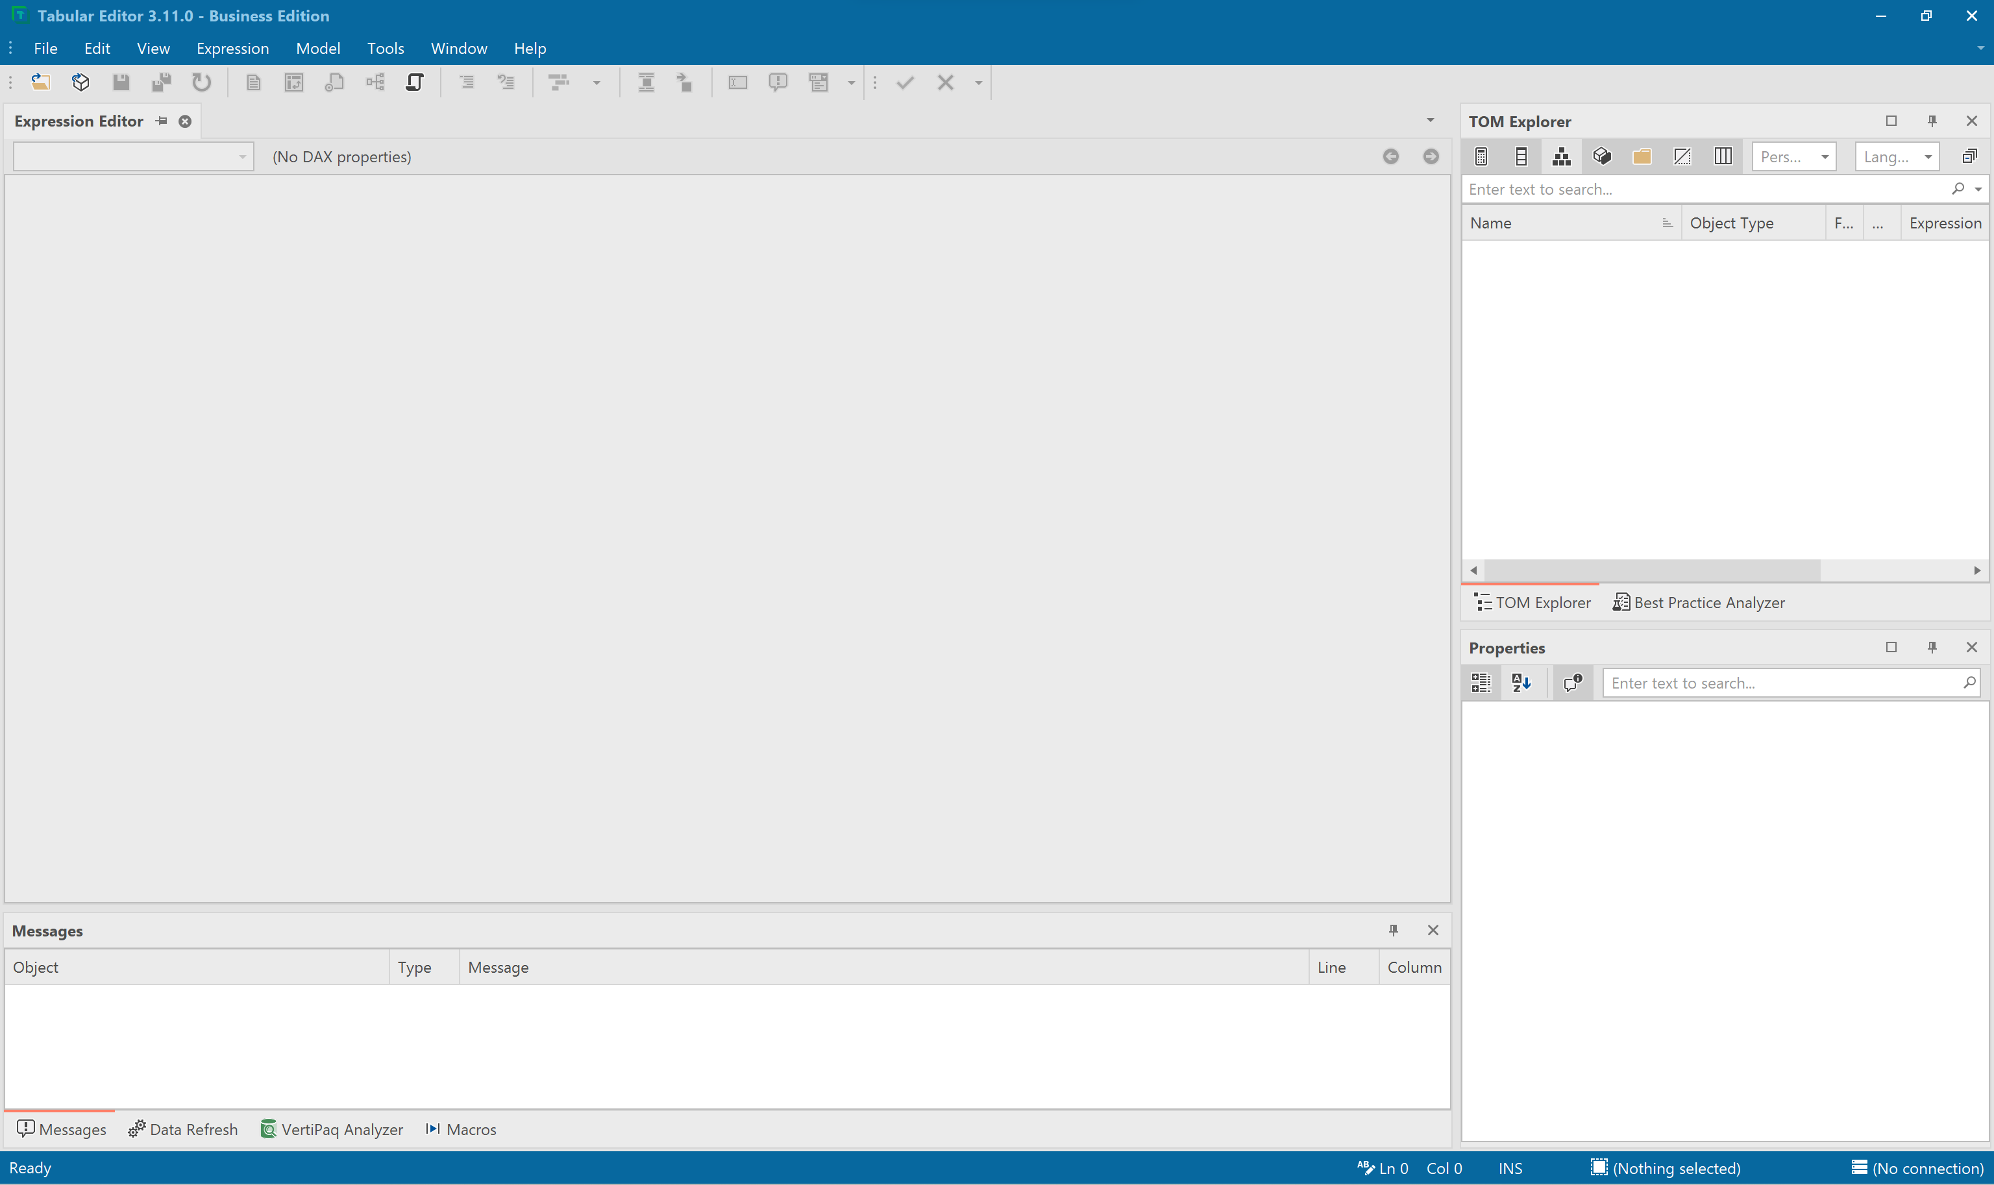
Focus on Desktop and Local Model

Slide 10
My favourite features
Layout of window
Filter
Format
Folders
Pivot Grid
DAX Queries
Best Practise Analyser
Expression Editor, TOM and Properties
Show Data
Show Dependencies
Find and Replace
Macros
Notes:
Layout of Window –
Go through pull out, increase, different window for different things
Go through TOM – what it is and properties – related to object
Show Data – Filter, Sort, …..
Create Countrows
Pivot Grid
Create C# Script – C:\Users\suebayes\AppData\Local\TabularEditor3
Create many measures
Create Folder
Show and talk through property pane
Create Running
Show Dependencies
DAX Script
Change Formatting
Change Names
Macros
powerbi.tips git hub
DAX Query
BPA

Slide 11
Tabular Editor
What is it?
How much will it cost me?
Who uses it?
Why?
How do I start?

Slide 12
Useful Resources
https://docs.tabulareditor.com/?tabs=TE3
https://tabulareditor.com/downloads
https://github.com/PowerBI-tips/TabularEditor-Scripts
https://powerbi.microsoft.com/en-us/blog/best-practice-rules-to-improve-your-models-performance/
Automatically generating measure descriptions for Power BI and Analysis Services with ChatGPT and Tabular Editor – Random Procrastination (gosbell.com)
https://www.youtube.com/watch?v=9_YrLSeM-Mo&t
Notes:
Mentimeter
Would you feel more inclined to have a play now?
Has this taken the fear away?
Questions?

Slide 13

Feedback
https://datarelay.co.uk/feedback

